Slide 1
Lacrosse Analytics: Improving Efficiency
Sol Benishay and Quinn Helmig

Slide 2
Why?
Both of us have a lot of lacrosse knowledge, both having played in high school and Quinn being a member of the varsity team here
The team has not been as successful as they could have been in the past
Both of us thought it would be very interesting to analyze what factors led to the teams wins and efficiency

Slide 3
What?
Analyzing the 2018 men’s teams data from the online website and variables collected on HUDL
We plan on using our knowledge of the game and statistics to figure out what factors have a statistically significant effect on efficiency
We defined efficiency as goal differential = goals forward-goals against
We want to find out which variables increase the teams goal forward output and decrease the opponents goals against
Once we find the relationships between the variables, our goal is to implement different remedies to the issues that we will reveal the team is facing

Slide 4
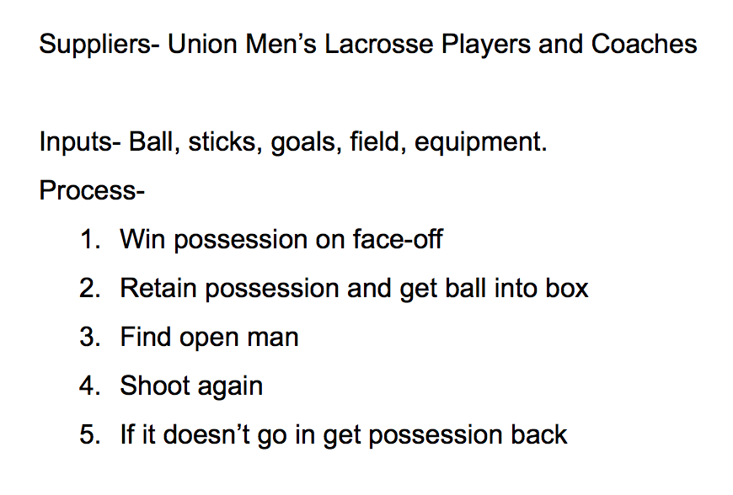
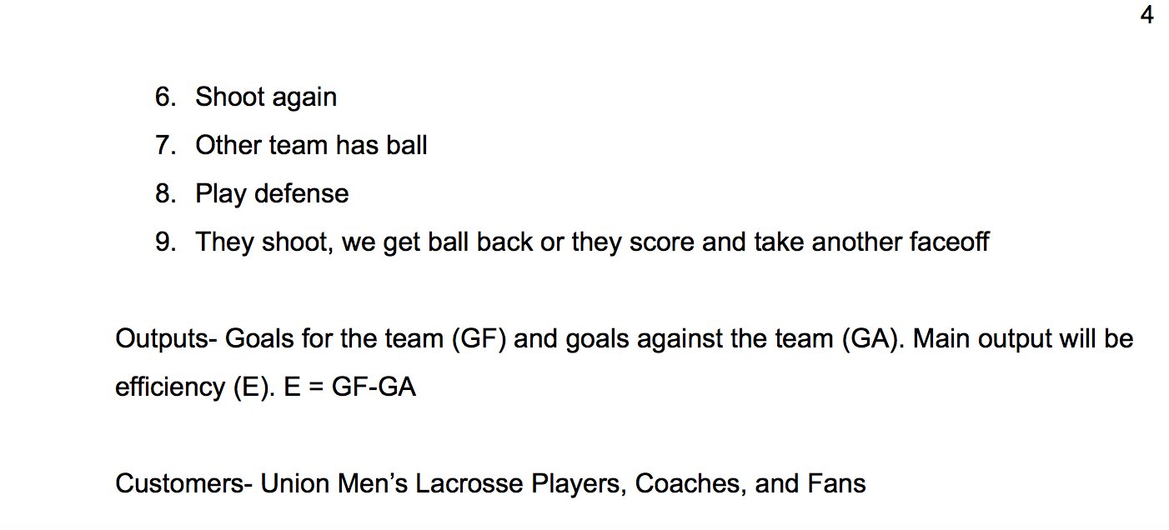
SIPOC

Slide 5
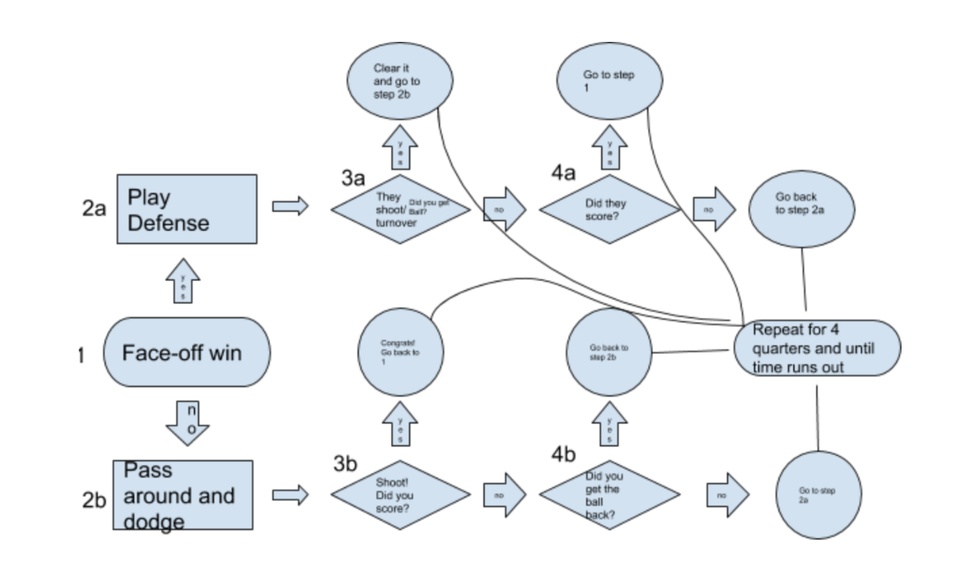
FLOWCHART

Slide 6
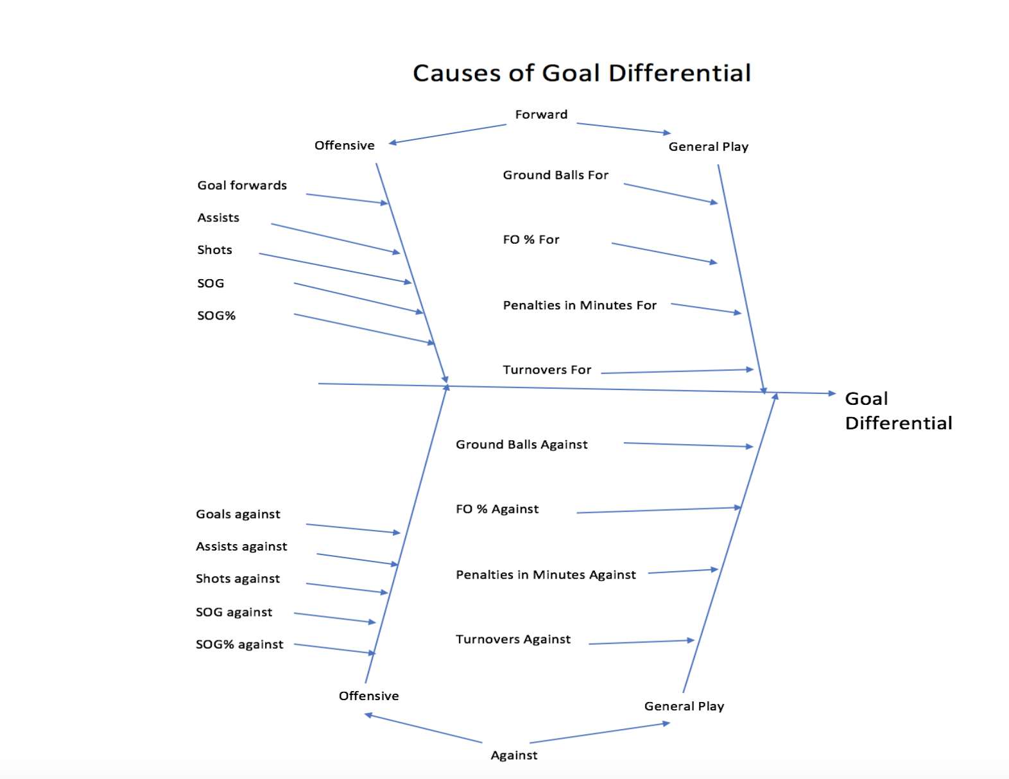
Fishbone Diagram

Slide 7
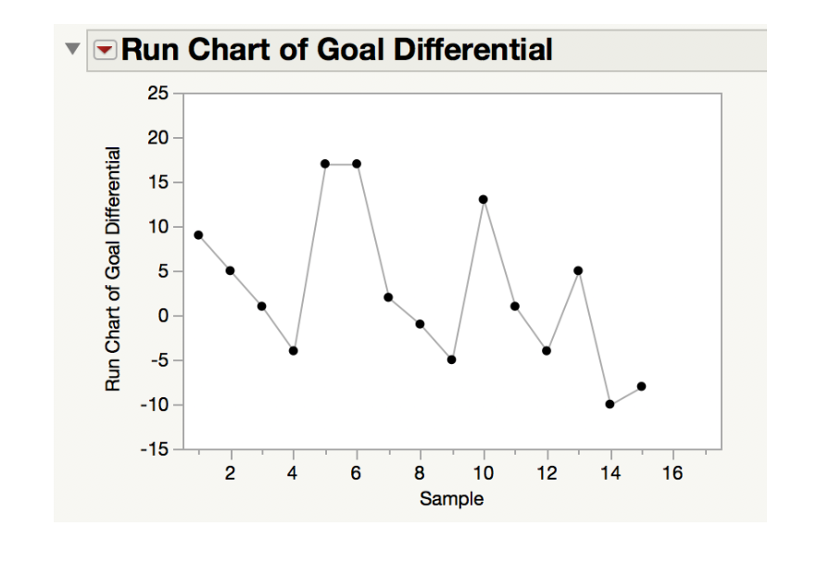
Process Stability

Slide 8
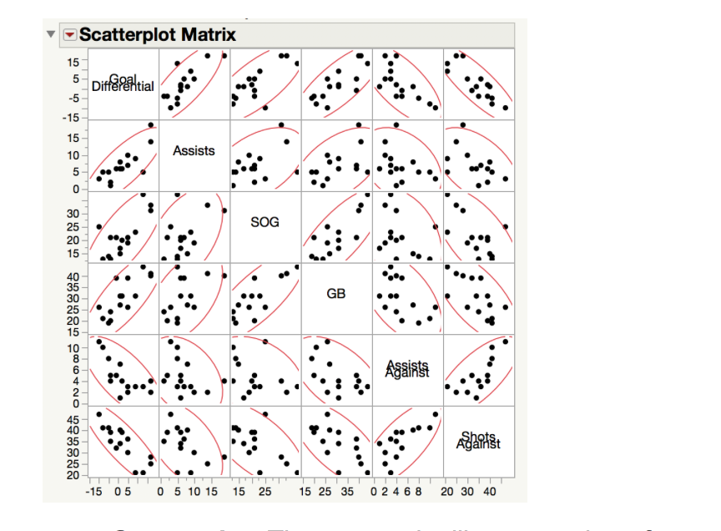
Scatterplot Matrix
We used the scatterplot matrix and the output from it to conclude that assists, shots on goal, ground balls, assists against, and shots against were the most important variables

Slide 9
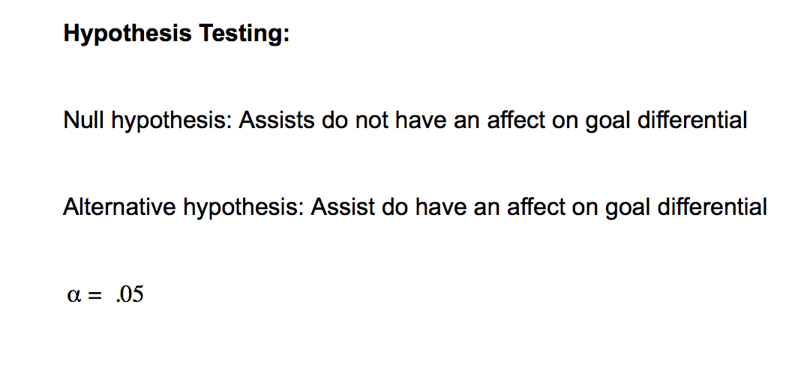
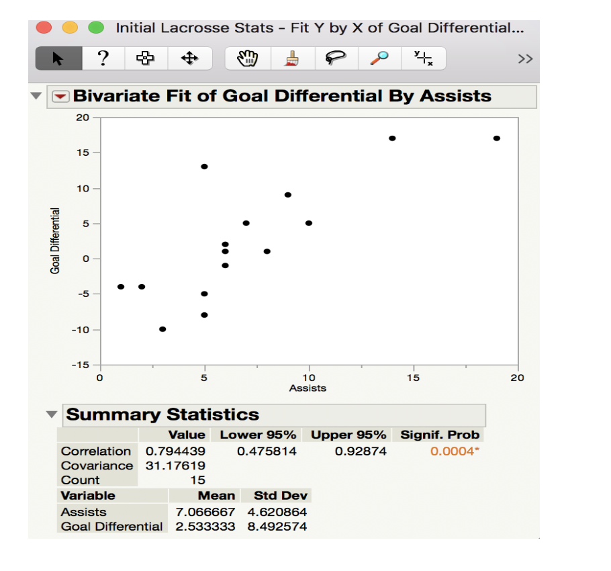
Assists Effect on Goal Differential

Slide 10
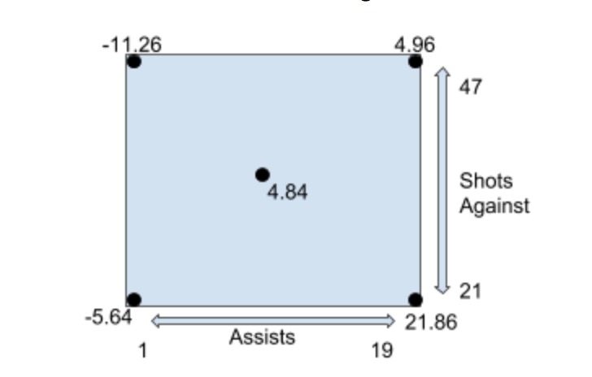
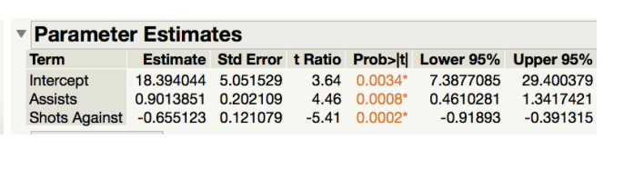
Designed Experiment
JMP Regression output for assists, shots against, and goal differential
Goal Differential = 18.394+.901(A)-.655(SA)

Slide 11
Conclusions
Assists and shots against have the most direct affect on goal differential
Optimal situation for a high goal differential is a lot of assists and low shots against
Experiment reaffirmed many of the clichés coaches say to their teams
Team, passing offense
Defense being of utmost importance
Future Steps
Remedies to get high assists: stressing of passing, teamwork when scoring, looking for the open man, and running drills to simulate assist situations
Remedies to get low shots against: emphasis of defensive techniques such as footwork, angle, and leverage. Not allowing employees to get shots off. Possibly implementing different defensive schemes.

